Slide 1

Securing Embedded Systems
Pavle Cvjetkovic F130812

Slide 2
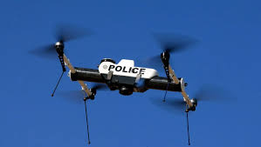
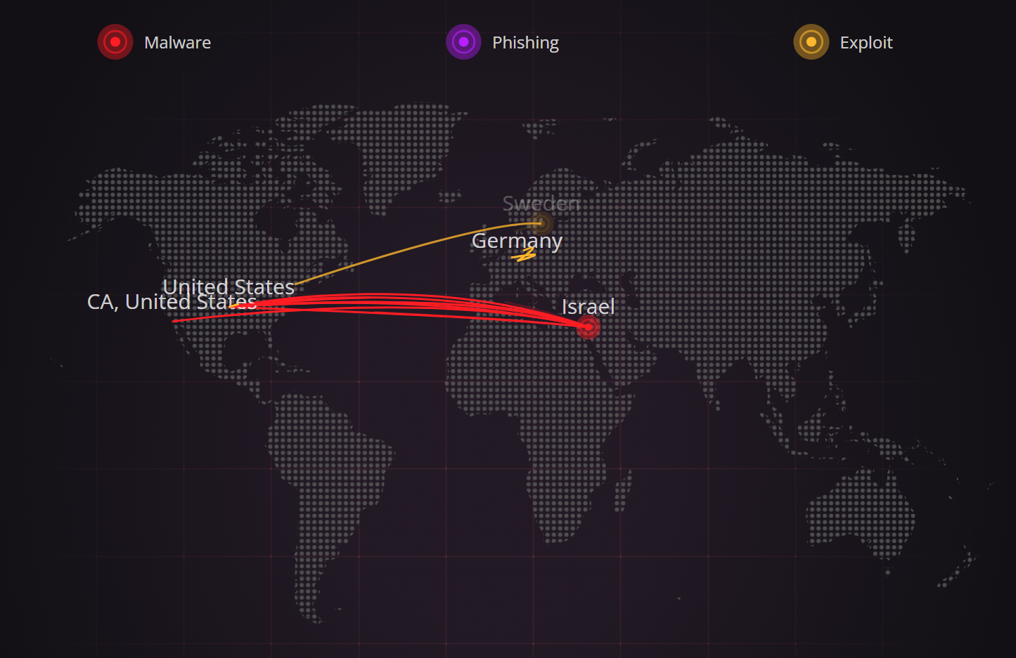
Project Motivation
Why Cybersecurity for Embedded Systems?
Rapid growth of embedded devices in critical applications: autonomous vehicles, drones, IoT devices
Increased exposure due to connectivity
Resource constraints make traditional methods unfeasible
Project Relevance
Drones are used in policing and security and need protection for firmware and sensitive data
Embedded platforms like STM32 are widely used and need efficient security solutions
Security Goals
Encryption: Prevent interception of private data
Integrity: Detect firmware tampering
Authentication: Ensure firmware origin with digital signatures
Global threat map shows active attack attempts. Embedded devices like drones and IoT nodes are becoming increasingly vulnerable.

Slide 3
Algorithms Overview
XTEA
Blowfish
SHA-256 + ECDSA
Lightweight symmetric cipher (64-bit block with 128-bit key)
Simple and small footprint
Great for memory-constrained devices
Used for benchmarking vs Blowfish
Symmetric cipher (64-bit block, variable key up to 448 bits)
More secure but more memory-intensive
Used in this project for encryption of data
Benchmarked vs XTEA
SHA-256: Used for firmware integrity verification
Hash generated post build using PostBuild_hash.bat
Verified at runtime using FW_Hash_Verify()
ECDSA (attempted):
Signature and key generation using OpenSSL

Slide 4
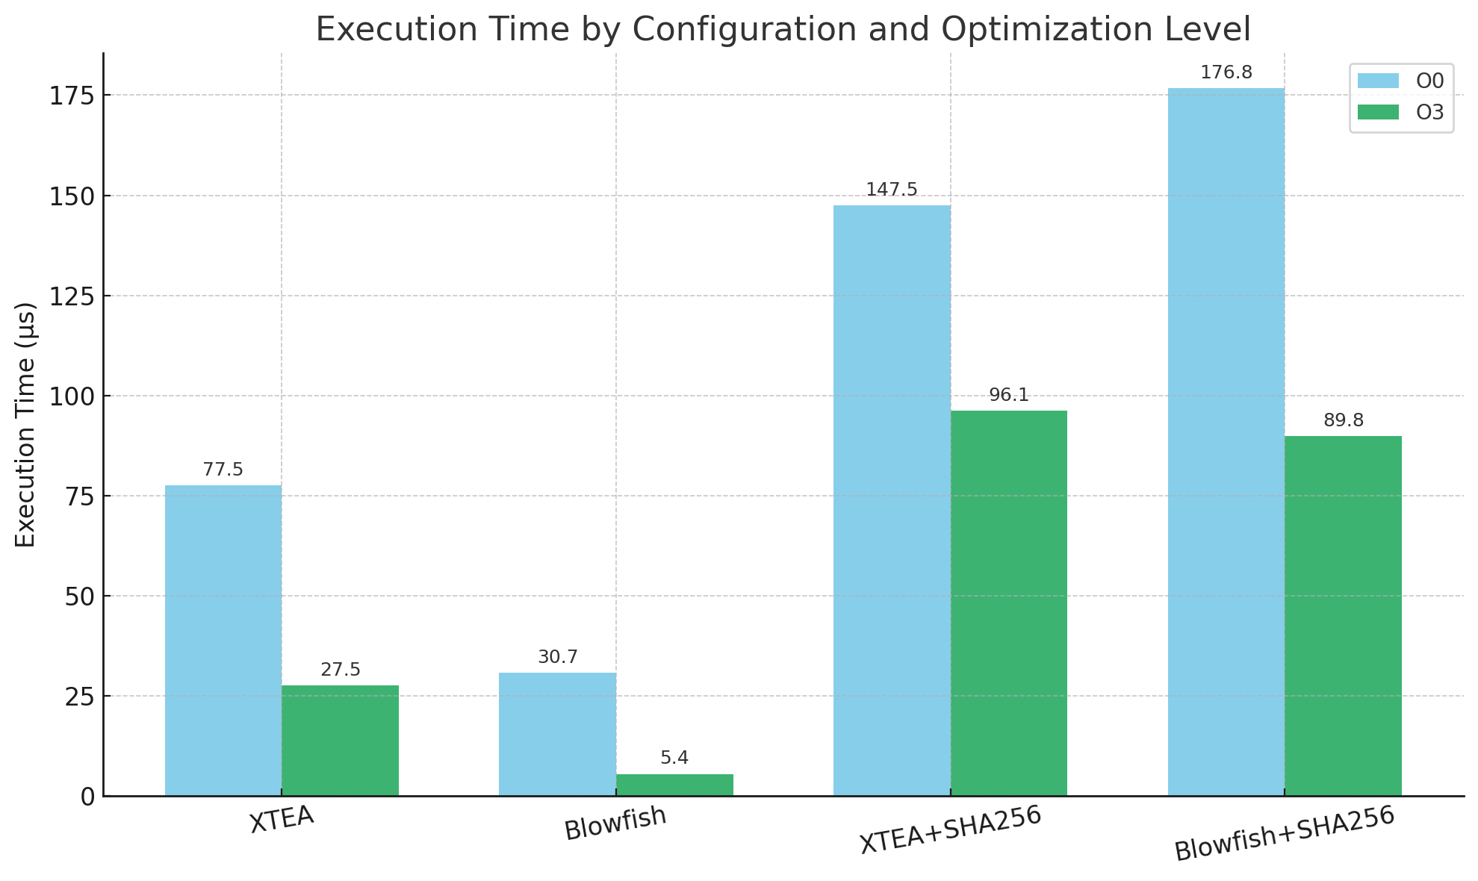
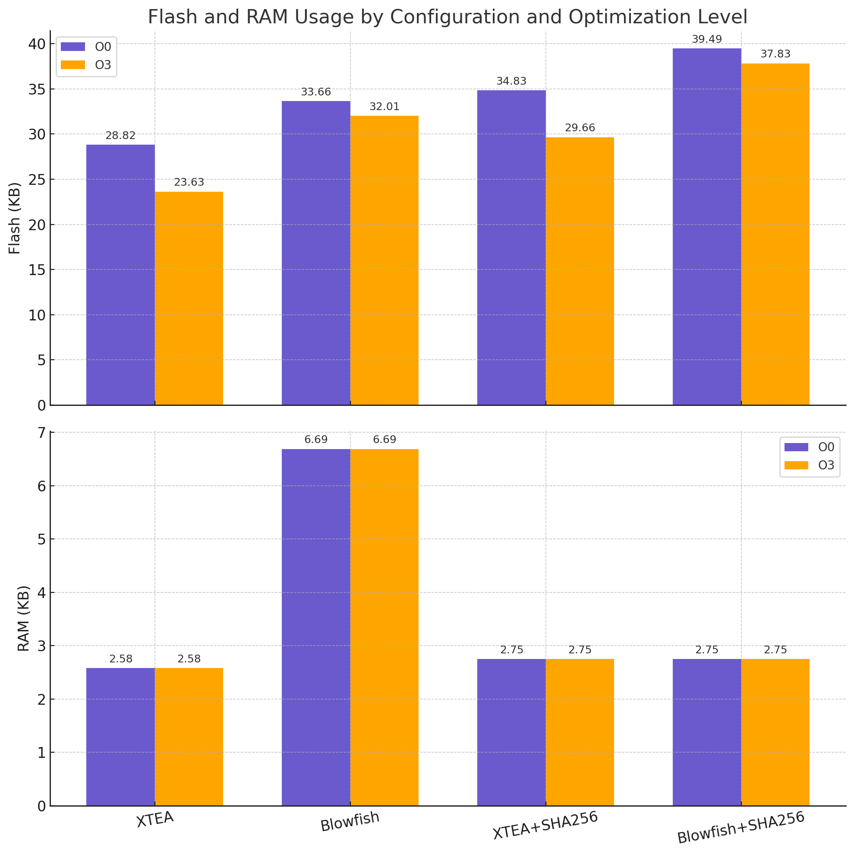
Performance Benchmarks: XTEA vs Blowfish
Model | Compilation Flag | Avg. Execution Time (µs) | Memory Utilisation
 |  |  | Flash (KB) |  | RAM (KB)
XTEA | O0 | 77.46 | 28.82 | 2.58
 | O3 | 27.52 | 23.63 | 2.58
Blowfish | O0 | 30.72 | 33.66 | 6.69
 | O3 | 5.42 | 32.01 | 6.69
XTEA + SHA256 | O0 | 147.50 | 34.83 | 2.75
 | O3 | 96.11 | 29.66 | 2.75
Blowfish + SHA256 | O0 | 176.76 | 39.49 | 2.75
 | O3 | 89.78 | 37.83 | 2.75
Values are averages over 100 iterations
Summary
Blowfish (O3): Performs fastest overall, but more memory
XTEA: Lower memory, decent speed – ideal for minimal solution
SHA-256: Added a ~2× slower runtime
Optimisation: (-O3): Showed a 5.6× performance boost for Blowfish

Slide 5
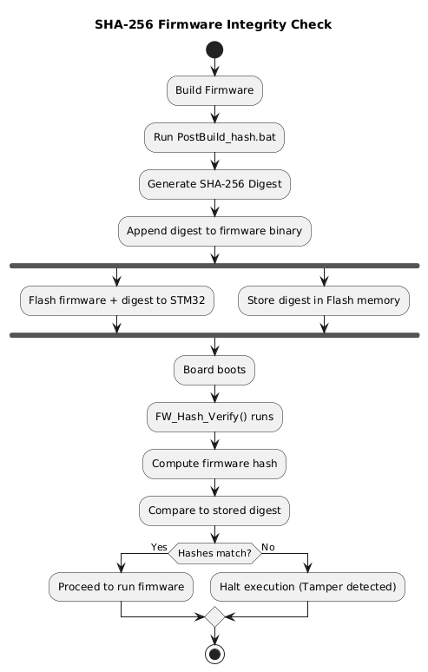

Firmware Integrity Check with SHA-256
Firmware Hashing
Post-build script PostBuild_hash.bat generates the SHA-256 digest
Digest appended to .bin file with padding
Verification on boot
Upon initiation of the program, FW_Hash_Verify() (from STM32 CryptoLib) is called
Computes the firmware hash
Compares it to the stored digest in Flash memory
Hash mismatch
Program halts
Simulates rejection of tampered firmware

Slide 6


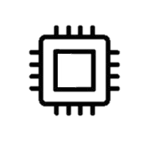


Secure Drone Mission Phases
Reads STM32F7’s 96-bit
factory UID using HAL:
uid[0] = HAL_GetUIDw0();
uid[1] = HAL_GetUIDw1();
uid[2] = HAL_GetUIDw2();
Random 6-digit number generated using STM32 RNG
Blowfish encrypts each new plate
Simulates surveillance scenario
Static message encrypted:
"Amazing Ost \o/"
Sent over UART, decrypted by Python Ground Station script
Demonstrate secure message delivery
UID split into two 64-bit blocks
Encrypted with Blowfish
Transmitted to Ground Station

Slide 7
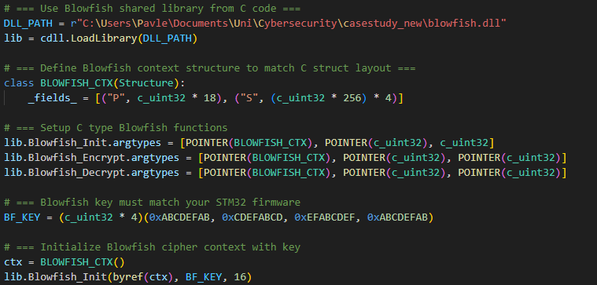
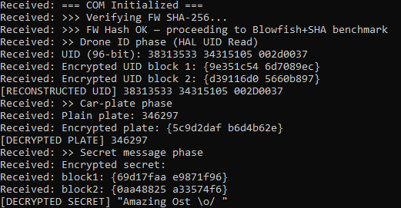
Decryption Pipeline on Ground Station
UART Reception
STM32 transmits Blowfish-encrypted 64-bit blocks
Baud rate: 115200, using HAL_UART_Transmit()
DLL Integration
Original blowfish.c/h compiled into blowfish.dll using gcc –shared
Enables same encryption logic on PC
Python Receiver
Pyserial receives incoming ciphertext
Ctypes loads blowfish.dll for decryption
Output data is live-decoded

Slide 8
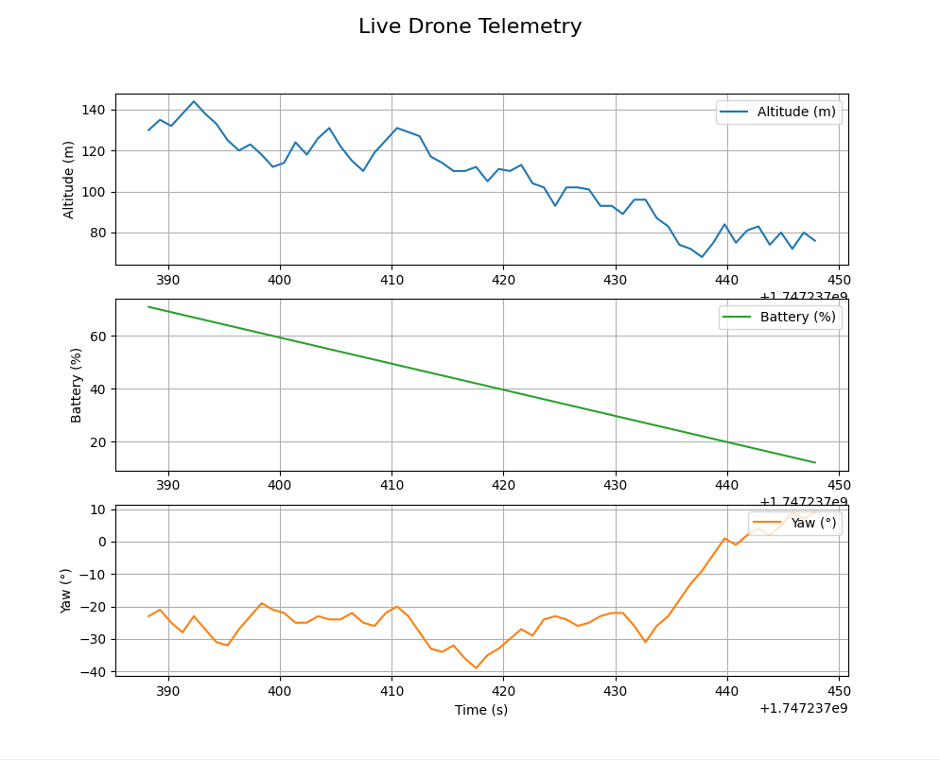
Beakman Challenge – Encrypted Telemetry
Telemetry Loop (on STM32)
Every second Updates:
                Latitude, Longitude
      Altitude, Roll, Pitch, Yaw
      Battery
      Encrypts each metric with Blowfish
      Sends encrypted blocks over UART
      Python Script
      Receives encrypted telemetry
      Decrypts each field using blowfish.dll
      Logs and plots values live using Matplotlib
Mission Logic
At 10% battery the RETURN mode is triggered
Initiates Descent
Outputs “Drone landed. Mission complete.”

Slide 9
Conclusion
Key Takeaways
STM32767ZI shows to support lightweight cryptography
XTEA and Blowfish algorithms deployed and benchmarked
SHA-256 implemented for firmware integrity to simulate a secure boot
Encrypted communication over UART between STM32 and PC
Beakman Challenge demonstrated real-time encryption, transmission, decryption and plotting
Limitations
ECDSA integration not successful due to middleware issues
MPU/WRP not fully leveraged yet
Future Work
Integrate full ECDSA firmware authentication
Use AES for modern cryptography algorithm
Apply tamper detection

Slide 10
Images Used
Police Drone Use
Source: Grepow Blog – What Are Police Drones Used For
Live Cyber Threat Map
Source: Checkpoint ThreatMap
A real-time visualization of global cyberattacks useful for motivation slides.
Hashing Icon (for firmware integrity)
Source: Flaticon – Hashing Icon

